Slide 1
Report On Analyzing Amazon Sales Data
Reported By
Dhivya K

Slide 2

Overview:
Sales management has gained importance to meet increasing competition and the need for improved methods of distribution to reduce cost and to increase profits. Sales management today is the most important function in a commercial and business enterprise.
To know about the Sales trend yearly, monthly, monthly yearwise and see some key metrics to improve sales, we’ll go through the following slides.

Slide 3
Dataset Insights:
Categorical columns
Numerical columns
Date columns
Order Id
Units Sold
Unit Price
Unit Cost
Total Revenue
Total Cost
Total Profit
Region
Country
Item Type
Sales Channel
Order Priority
Region
Country
Item Type
Sales Channel
Order Priority
Order Date
Ship Date

Slide 4
The dataset consists of 100 records and 14 columns.
It consists of 7 numerical and 5 categorical columns and 2 date columns.
The categories of categorical columns:
Region : 7 categories
Country : 76 categories
Item Type : 12 categories
Sales Channel: 2 categories
Order Priority: 4 categories

Slide 5
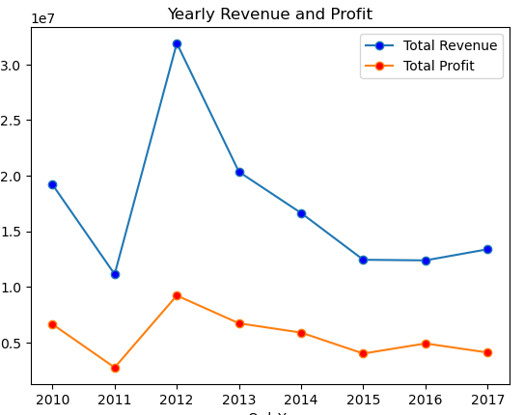
Yearly Sales Trend:
REVENUE vs YEAR
Total Revenue:
Starting from 20M in the year 2010, the sales has a downfall in the year 2011 and a high rise in revenue of above 30M in the year 2012, which is recorded as the highest among the years. Then there was a downfall in the Revenue till 2016.
Total Profit:
The highest profit is recorded in the year 2012 around 10M and the lowest in the year 2011.

Slide 6
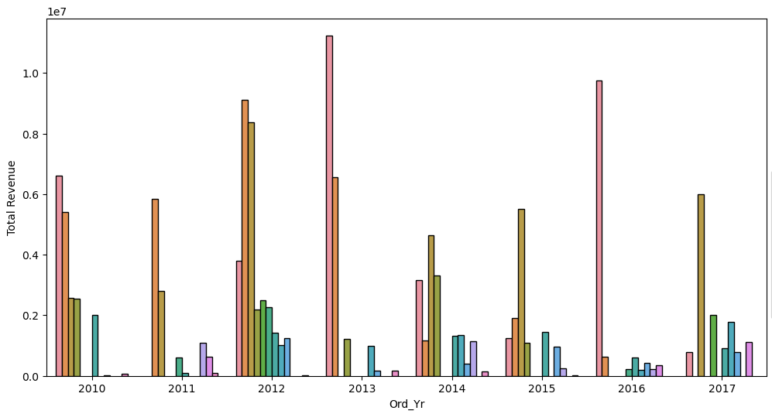
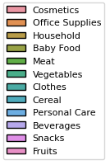
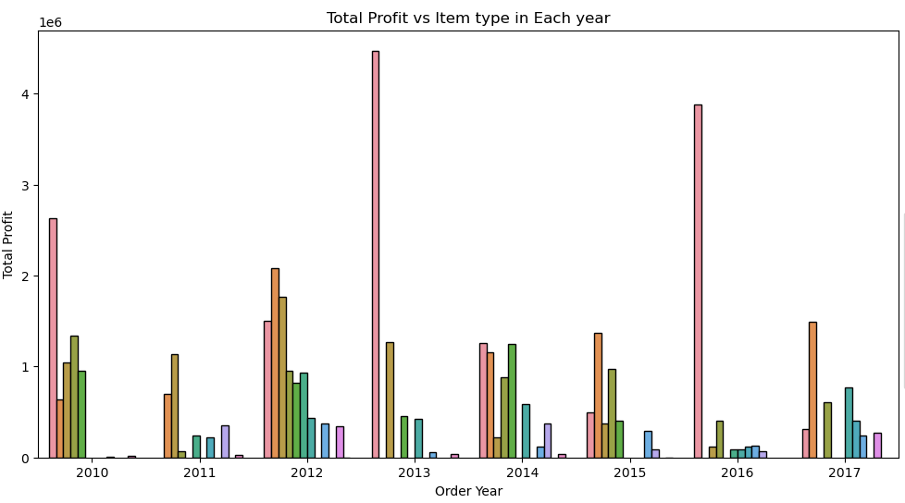
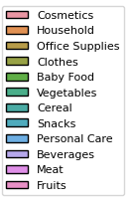
Item Revenue/Item Profit vs Year:
The cosmetics sale was the highest in yielding revenue in the years like 2010,2013,2016.
The other leading items in revenue are Office Supplies in the years 2011,2012. and Household in the years 2014,2015,2017.
The Cosmetics yields a huge sum of profit as well in all the years but specially in 2010,2013,2014,2016.
The other leading items in profit are Household in the years 2012,2015,2017 and Office Supplies in the years 2011.

Slide 7
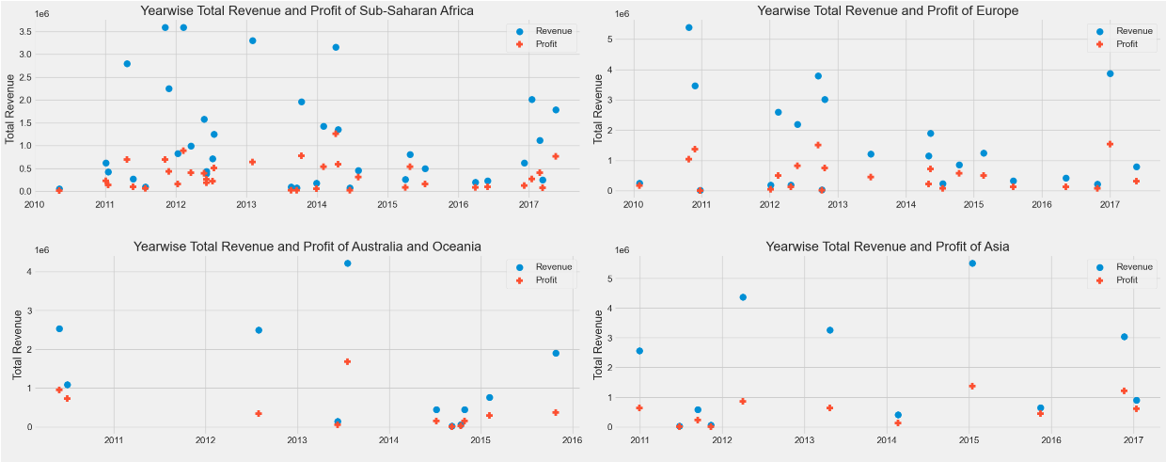
Regional Revenue/Regional Profit vs Year:
The Highest revenue of Sub-Saharan Africa was recorded in the year 2011 of around 3.5M and the highest profit in the year 2014 of around 1M.
The highest revenue of Europe was in the year 2010 of 5.3M and the highest profit in the year 2016 of 1.5M
The highest revenue of Australia and Oceania was in the year 2013 of 4.2M and the highest profit in the year 2013.
The highest revenue of Asia was in the year 2015 of 5.5M and the highest profit in the year 2015 of 1.3M

Slide 8
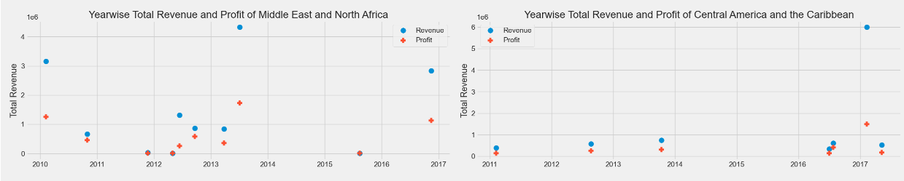
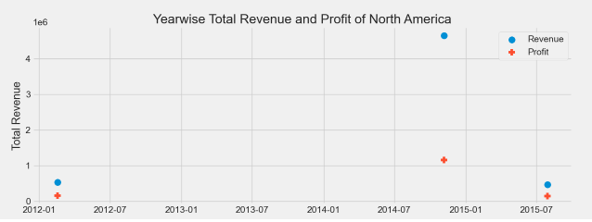
The Highest revenue of Middle East and North Africa was recorded in the year 2013 of 4.3M and the highest profit in the year 2013 of around 1.7M.
The Highest revenue of Central America and the Caribbean was in the year 2017 of around 5.9M and the highest profit in the year 2017 of around 1.4M.
The Highest revenue of North America was recorded in the year 2014 of around 4.6M and the highest profit in the year 2014 of around 1.1M.

Slide 9
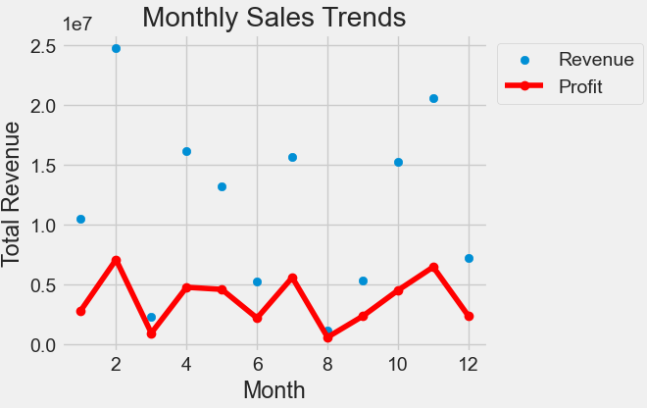
Monthly Sales Trend:
REVENUE/PROFIT vs MONTH
Revenue:
The highest revenue of around 25M was achieved in the month of February irrespective year.
The second highest was recorded in the month of November around 20M.
And the lowest was in the month of August.
Profit:
As the revenue leads, the profit was also leaded in the month of February of around 7M, followed by November around 6M.

Slide 10
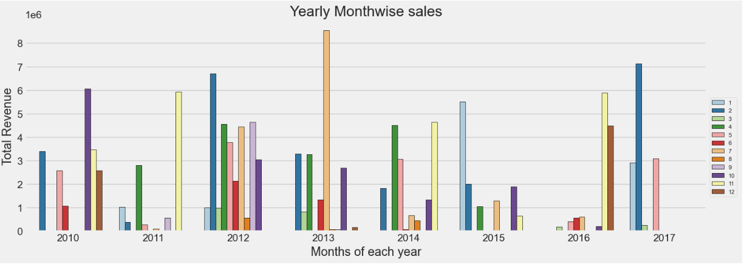
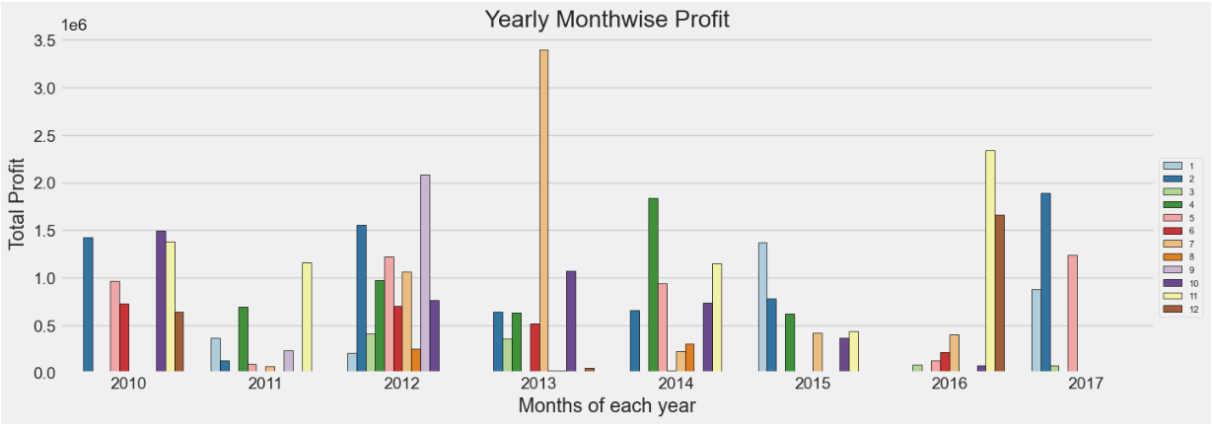
Yearly Monthwise Sales Trend:
REVENUE/PROIT vs YEAR/MONTH
Revenue:
In the year of 2011,2016and 2017 there was not even an average amount of sale in the months, whereas in the year 2012, there was a good amount sale throughout the year.
In the month of July ,2013 the revenue was recorded the highest.
Profit:
Reasonable profits according to the revenue yielded throughout the respective months/year can be seen.

Slide 11
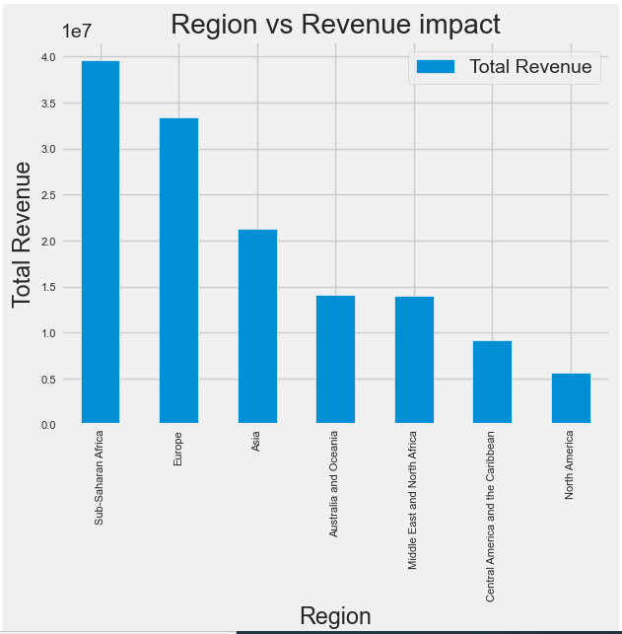
REGION :
REGION vs REVENUE
Sub-Saharan Africa, Europe, Asia are the top 3 leading revenue regions.

Slide 12
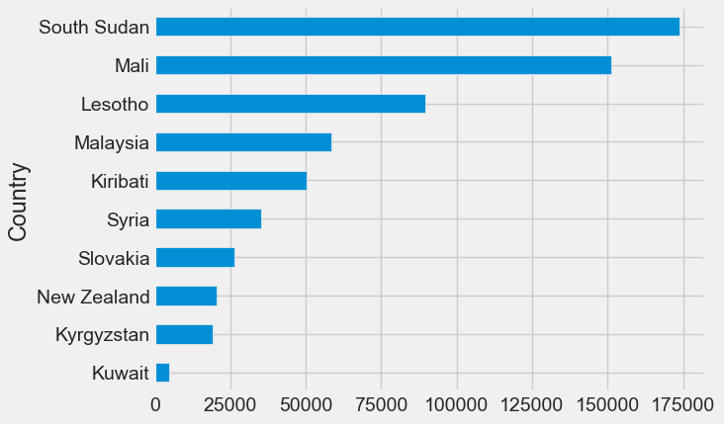
Country :
COUNTRY vs REVENUE
South Sudan, Mali, Lesotho are the top 3 revenue yielding countries.

Slide 13
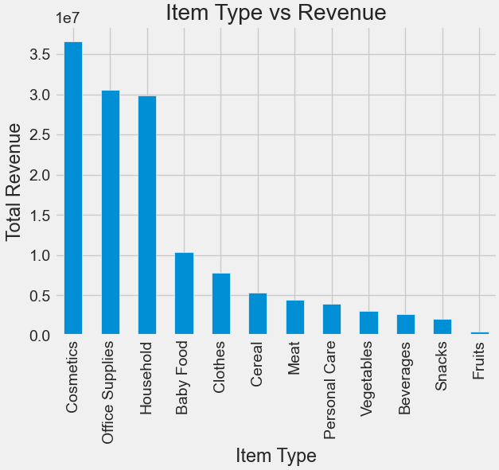
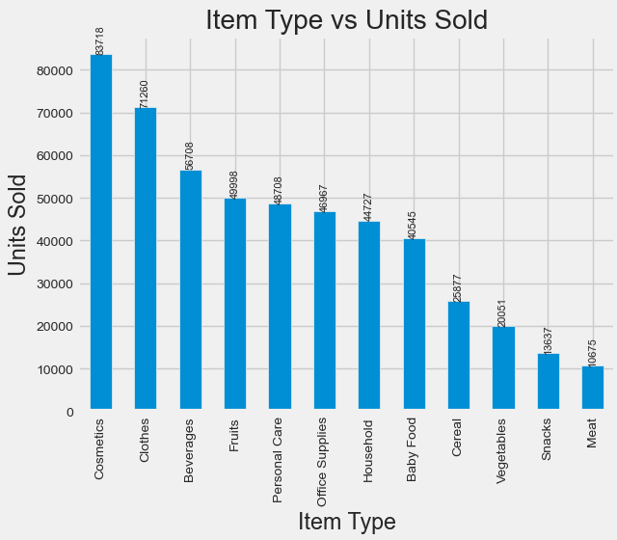
Item Type:
ITEM TYPE vs REVENUE
Cosmetics, Office Supplies, Household are the top 3 leading products in yielding revenue.
Cosmetics, Clothes, Beverages are the products in which the maximum number of units are sold throughout.

Slide 14
Other Key Factors
FEATURES IN THE DATASET
S
Sales Channel
Order Priority
O
Both sales channel (online and offline) contributes majorly in the sales where Offline plays a slightly major role.
H type order priority yields the highest revenue, followed by L type and others.
Unit Cost
Unit Price
C
P
The Office Supplies(524.96), Household(502.54), Cosmetics(263.33) has the highest unit cost comparatively to the other items. Therefore they yield a great revenue with less number of units sold.
Unit Price is much similar to the cost price and does not have any significant value in yielding revenue..

Slide 15
Conclusion:
The year 2012 had the highest Revenue at 31.89M, followed by 2013 at 20.33M and 2010 at 19.18M
If we observe the monthly insights of 2012,2013,2010, the sales are at their peak in February, July, October and are low in December, September and August. Amazon can come up with some good discounts and offers to generate high revenue.
The sales for the South Sudan are highest among all countries and lowest in Brunei.
The Cosmetics, Office Supplies and House hold are the highest selling products in the markets.

